Slide 1
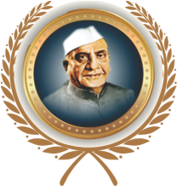
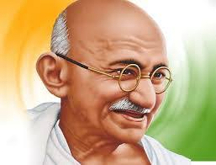
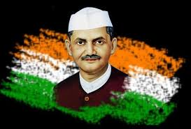
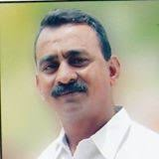
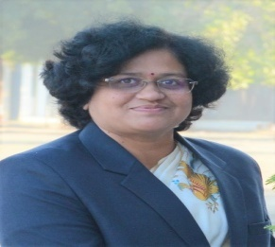
Shri Shivaji Education, Society Amravati’s
Shri Shivaji College of Physical Education, Amravati.
ONE DAY ONLINE WEBINAR
RASHITRAPITA MAHATAMA GANDHI AND LAL BAHADUR SHASTRI BIRTH ANNIVERSARY
Guest of Honour
Principal / Convener
Date : 2nd OCT, 2020. time : 10.00 am
Prof. Shri Pradipji Khedkar
President Sant Gadge Baba Amravati Vidyapith Shikshan
Manch & D.P.E. of Narsamma Art, Commerce And Science College, Amravati
Dr. Anjali Thakare
Principal
Shri Shivaji College of Physical Education .
Amravati.
Join us through Zoom : https://us02web.zoom.us/j/8134585663

Slide 2
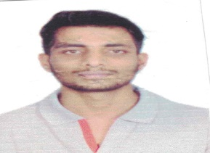
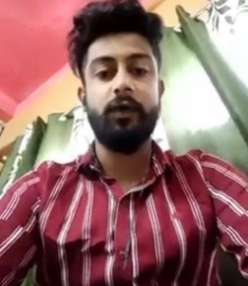
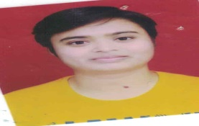
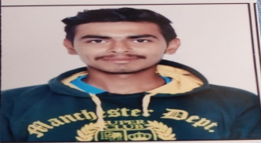
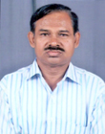
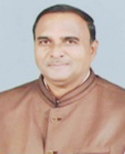
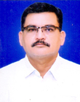
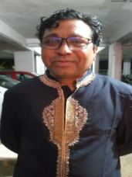
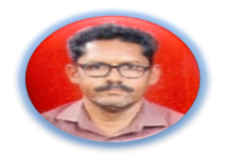
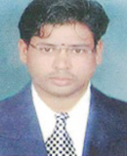
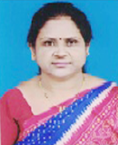
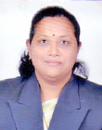
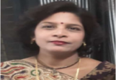
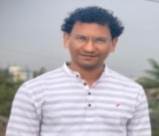
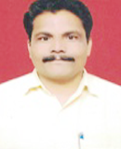
Special invitee – College Students
Shri. Akshay Alaspure
Shri. Arbind Prasad
Ku.Samiksha Barve
Shri. Ankush Abhishak
(B.P.E.S.)
(B.P.Ed.)
(B.P.E.S.)
(B.P.Ed.)
SPECIAL : CORE Members our College Staff
Shri Rajendra D. Dongre
Shri Shankar P. Raut
Dr. Ulhas V. Deshmukh
Shri Nilesh Thakare
Dr. Vinod P. Masram
Dr. Premsingh S. Sayar
Ms. Swati K. Deshmukh
Dr. Pushpalata M. Deshmukh
Mrs. Swati Nyahatkar
Dr. Chetak Shende
Shri Promod A. Ingale
Ku. Amruta Gulhane
Shri Dhiraj Deshmukh
College website : http://www.shivajibpedamt.org/index.php Contact : 0721-2662427

